Slide 1
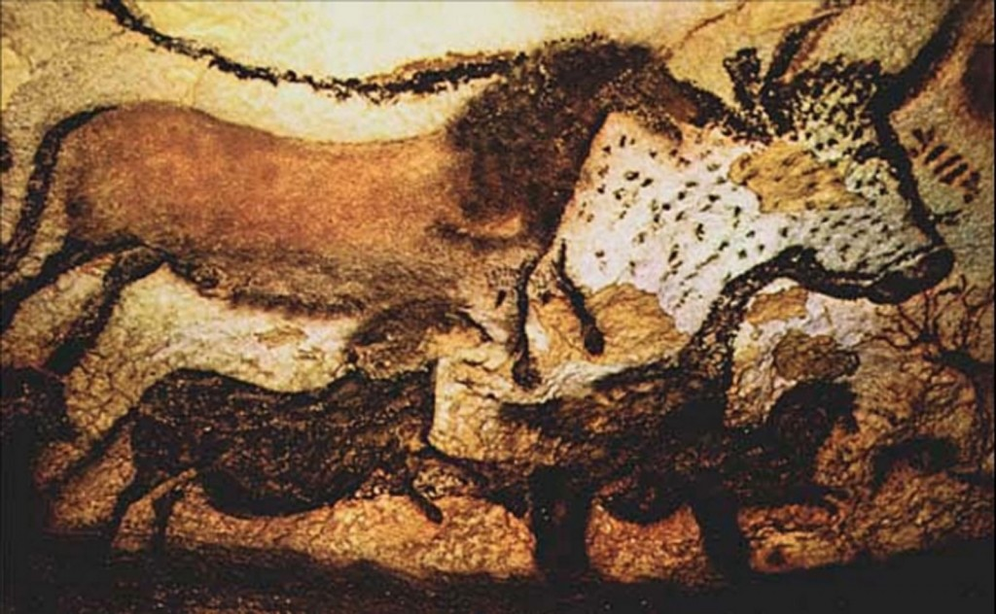
Lascaux Caves c. 20,000 years ago

Slide 2
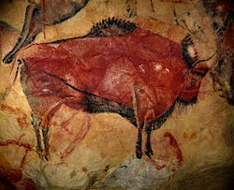
Lascaux Caves c. 20,000 years ago

Slide 3
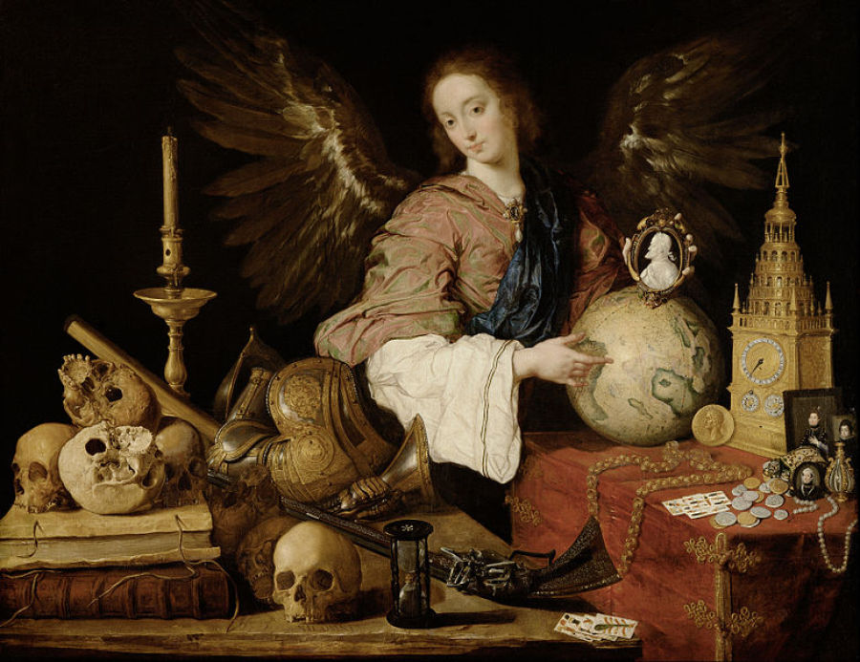
Antonio de Pereda, “Allegory of Vanity,” c. 1632 - 1636, Kunsthistorisches Museum.

Slide 4
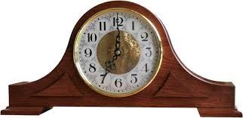

Slide 5
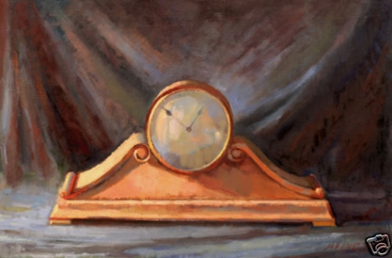

Slide 6
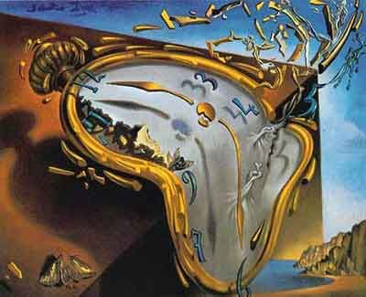
Melting Watch, Salvador Dali, 1931

Slide 7
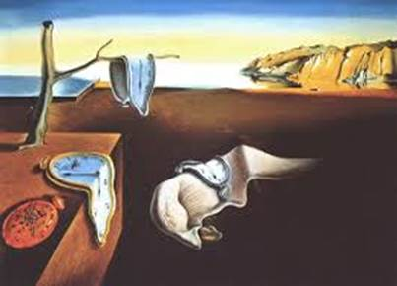
Salvador Dali: The Persistence of Memory, 1931

Slide 8
Rodin: The Kiss, 1899

Slide 9
Magritte: The Lovers, 1928

Slide 10
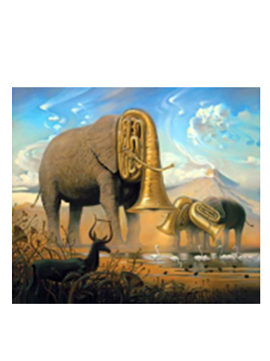

Slide 11
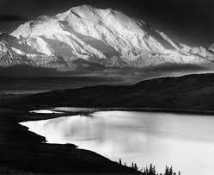
Ansell Adams

Slide 12
The Absurd

Slide 13
“The absurd is the essential concept
and the first truth.” ― Albert Camus
“Man stands face to face with the irrational.
He feels within him his longing for
happiness and for reason.
The absurd is born of this confrontation
between the human need and the
unreasonable silence of the world.” ― Albert Camus,
The Myth of Sisyphus and Other Essays

Slide 14
When the plays of Ionesco, Beckett, Genet, and Adamov first appeared on the stage they puzzled and outraged most critics as well audiences. And no wonder. These plays flout all the standards by which drama has been judged for many centuries; they must therefore appear as a provocation to people who have come into the theatre expecting to find what they would recognize as a well-made play. A well-made play is expected to present characters that are well-observed and convincingly motivated: these plays often contain hardly any recognizable human beings and present completely unmotivated actions. A well-made play is expected to entertain by the ding-dong of witty and logically built-up dialogue: in some of these plays dialogue seems to have degenerated into meaningless babble. A well-made play is expected to have a beginning, a middle, and a neatly tied-up ending: these plays often start at an arbitrary point and seem to end just as arbitrarily. By all the traditional standards of of critical appreciation of the drama, these plays are not only abominably bad, they do not even deserve the name drama.
And yet, strangely enough, these plays have worked, they have had an effect, they have exercised a fascination of their own in the theatre. At first it was said that this fascination was merely a succès de scandale, that people flocked to see Beckett's Waiting for Godot or Ionesco's Bald Primadonna merely because it had become fashionable to express outrage and astonishment about them at parties. But this explanation clearly could not apply to more than one or two plays of this kind. And the success of a whole row of similarly unconventional works became more and more manifest. If the critical touchstones of conventional drama did not apply to these plays, this must surely have been due to a difference in objective, the use of different artistic means, to the fact, in short, that these plays were both creating and applying a different convention of drama. It is just as senseless to condemn an abstract painting because it lacks perspective or a recognizable subject-matter as it is to reject Waiting for Godot because it has no plot to speak of. In painting a composition of squares and lines an artist like Mondrian does not want to depict any object in nature, he does not want to create perspective. Similarly, in writing Waiting for Godot Beckett did not intend to tell a story, he did not want the audience to go home satisfied that they knew the solution to the problem posed in the play. Hence there is no point in reproaching him with not doing what he never sought to do; the only reasonable course is to try and find out what it was that he did intend.
Martin Esslin, Introduction to "Absurd Drama" (Penguin Books, 1965)

Slide 15
Why should the emphasis in drama have shifted away from traditional forms towards images which, complex and suggestive as they may be, must necessarily lack the final clarity of definition, the neat resolutions we have been used to expect? Clearly because the playwrights concerned no longer believe in the possibility of such neatness of resolution. They are indeed chiefly concerned with expressing a sense of wonder, of incomprehension, and at times of despair, at the lack of cohesion and meaning that they find in the world. If they could believe in clearly defined motivations, acceptable solutions, settlements of conflict in tidily tied up endings, these dramatists would certainly not eschew them. But, quite obviously, they have no faith in the existence of so rational and well ordered a universe. The 'well-made play' can thus be seen as conditioned by clear and comforting beliefs, a stable scale of values, an ethical system in full working condition. The system of values, the world-view behind the well-made play may be a religious one or a political one; it may be an implicit belief in the goodness and perfectibility of men (as in Shaw or Ibsen) or it may be a mere unthinking acceptance of the moral and political status quo (as in most drawing-room comedy). But whatever it is, the basis of the well-made play is the implicit assumption that the world does make sense, that reality is solid and secure, all outlines clear, all ends apparent. The plays that we have classed under the label of the Theatre of the Absurd, on the other hand, express a sense of shock at the absence, the loss of any such clear and well-defined systems of beliefs or values. There can little doubt that such a sense of disillusionment, such a collapse of all previously held firm beliefs is a characteristic feature of our own times. The social and spiritual reasons for such a sense of loss of meaning are manifold and complex: the waning of religious faith that had started with the Enlightenment and led Nietzsche to speak of the 'death of God' by the eighteen-eighties; the breakdown of the liberal faith in inevitable social progress in the wake of the First World War; the disillusionment with the hopes of radical social revolution as predicted by Marx after Stalin had turned the Soviet Union into a totalitarian tyranny; the relapse into barbarism, mass murder, and genocide in the course of Hitler's brief rule over Europe during the Second World War; and, in the aftermath of that war, the spread of spiritual emptiness in the outwardly prosperous and affluent societies of Western Europe and the United States. There can be no doubt: for many intelligent and sensitive human beings the world of the mid twentieth century has lost its meaning and has simply ceased to make sense. Previously held certainties have dissolved, the firmest foundations for hope and optimism have collapsed. Suddenly man sees himself faced with a universe that is both frightening and illogical - in a word, absurd. All assurances of hope, all explanations of ultimate meaning have suddenly been unmasked as nonsensical illusions, empty chatter, whistling in the dark. If we try to imagine such a situation in ordinary life, this might amount to our suddenly ceasing to understand the conversation in a room full of people; what made sense at one moment has, at the next, become an obscure babble of voices in a foreign language. At once the comforting, familiar scene would turn into one of nightmare and horror. With the loss of the means of communication we should be compelled to view that world with the eyes of total outsiders as a succession of frightening images. Such a sense of loss of meaning must inevitably lead to a questioning of the recognised instrument for the communication of meaning: language. Consequently the Theatre of the Absurd is to a very considerable extent concerned with a critique of language, an attack above all on fossilized forms of language which have become devoid of meaning.
Martin Esslin, Introduction to "Absurd Drama" (Penguin Books, 1965)

Slide 16
To find a form that accommodates the mess, that is the task of the artist now.
Samuel Beckett

Slide 17
Bare interior
Grey light.
Left and right back, high up, two small windows, curtains drawn.
Front right, a door. Hanging near door, its face to wall, a picture.
Front left, touching each other, covered with an old sheet, two ashbins.
Centre, in an armchair on casters, covered with an old sheet, Hamm.
Motionless by the door, his eyes fixed on Hamm, Clov. Very red face.
Brief tableau.

Slide 18
The stage represents a gloomy brick cavern with spectral light, two grotesque windows
that can be reached only by a ladder, scabrous walls, rubble, decay. There are four characters – an
Irascible, blind tycoon in a hard hat and rags, sitting in a battered pulpit chair; his shuffling, groaning
slave who drags himself around the stage on futile errands, an elderly man and an elderly woman who
live in two ashcans. Once or twice during the course of Mr. Beckett’s harangue of disgust they poke their
death-like faces above the rims of the ashcans and act as a grisly chorus to the main theme.
Apparently the place is somewhere between life and death, and the time is just short of the night of the
earth’s last whimper. Don’t expect this column to give a coherent account of what – if anything – happens
Almost nothing happens in the sense of action.
But Mr. Beckett, destitute of hope, is flinging a shroud across earth’s last revels. He is painting a portrait
of desolation, lovelessness, boredom, ruthlessness, sorrow, nothingness. Looking out of the window
through a telescope, Clov reports what he sees: “Zero, and zero and zero.” Mr. Becket is preparing us for
oblivion.
Brooks Atkinson, 1958

Slide 19
Hamm:
Our revels now are ended

Slide 20
Prospero:
Our revels now are ended.
These our actors,
As I foretold you, were all spirits and
Are Melted into air, into thin air:
And like the baseless fabric of this vision
The cloud–capp’d towers, the gorgeous palaces,
The solemn temples, the great globe itself,
Yea, all which it inherit, shall dissolve
And, like this insubstantial pageant faded
Leave not a rack behind.
We are such stuff
As dreams are made on, and our little life
Is rounded with a sleep.
William Shakespeare, The Tempest

Slide 21
Richard:
“My kingdom for a horse!”
Shakespeare, Richard the Third
p. 23
HAMM:
My kingdom for a nightman!

Slide 22
p. 9
HAMM:
Accursed progenitor!
NAGG:
Me pap!
HAMM:
The old folks at home! No decency left! Guzzle, guzzle, that's all they think of.
(He whistles. Enter Clov. He halts beside the chair.)
Well! I thought you were leaving me.
CLOV:
Oh not just yet, not just yet.
NAGG:
Me pap!
HAMM:
Give him his pap.
CLOV:
There's no more pap.
HAMM (to Nagg):
Do you hear that? There's no more pap. You'll never get any more pap.
NAGG:
I want me pap!
HAMM:
Give him a biscuit.
(Exit Clov.)
Accursed fornicator! How are your stumps?

Slide 23
12
HAMM:
This is slow work.
(Pause.)
Is it not time for my pain-killer?
CLOV:
No.
(Pause.)
I'll leave you, I have things to do.
HAMM:
In your kitchen?
CLOV:
Yes.
HAMM:
What, I'd like to know.
CLOV:
I look at the wall.
HAMM:
The wall! And what do you see on your wall?
Mene, mene? Naked bodies?
CLOV:
I see my light dying.

Slide 24
Mene, mene tekel upharsin.

Slide 25
CLOV:
Things are livening up.
(He gets up on the ladder, raises telescope, lets it fall.)
I did it on purpose.
(He gets down, picks up the telescope, turns it on auditorium.)
I see . . . a multitude . . . in transports . . . of joy.
(Pause)
That’s what I call a magnifier.
(He lowers the telescope, turns toward Hamm.)
Well? Don’t we laugh?
29

Slide 26
HAMM (after reflection):
I don't.
CLOV (after reflection):
Nor I.
(He gets up on ladder, turns the telescope on the without.)
Let's see.
(He looks, moving the telescope.)
Zero...
(he looks)
...zero...
(he looks)
...and zero.
HAMM:
Nothing stirs. All is—
CLOV:
Zer—
HAMM (violently):
Wait till you're spoken to!
(Normal voice.)
All is... all is... all is what?
(Violently.)
All is what?
CLOV:
What all is? In a word? Is that what you want to know? Just a moment.
(He turns the telescope on the without, looks, lowers the telescope, turns towards Hamm.)
Corpsed.
(Pause.)
Well? Content?

Slide 27
HAMM (as before):
That's right.
(Exit Clov. Pause.)
Me to play.
(He takes out his handkerchief, unfolds it, holds it spread out before him.)
We're getting on.
(Pause.)
You weep, and weep, for nothing, so as not to laugh, and little by little... you begin to grieve.
(He folds the handkerchief, puts it back in his pocket, raises his head.)
All those I might have helped.
(Pause.)
Helped!
(Pause.)
Saved.
(Pause.)
Saved!
(Pause.)
The place was crawling with them
(Pause. Violently.)
Use your head, can't you, use your head, you're on earth, there's no cure for that!
(Pause.)
68

Slide 28
. . .
(Pause.)
It will be the end and there I'll be, wondering what can have brought it on and wondering what can have...
(he hesitates)
...why it was so long coming.
(Pause.)
There I'll be, in the old shelter, alone against the silence and...
(he hesitates)
...the stillness. If I can hold my peace, and sit quiet, it will be all over with sound, and motion, all over and done with.
(Pause)
I’ll have called my father and I’ll have called my . . .
(he hesitates)
. . . my son. And even twice, or three times, in case they shouldn’t have heard me, the first time, or the second.
(Pause)
I’ll say to myself, He’ll come back.
69

Slide 29
p. 53
It was an exceedingly dry day, I remember,
zero by the hygrometer. Ideal weather, for my lumbago.
(Pause. Violently.)
But what in God's name do you imagine?
That the earth will awake in the spring?
That the rivers and seas will run with fish again?
That there's manna in heaven still for imbeciles like you?

Slide 30
Enough of that, it's story time, where was I?
(Pause. Narrative tone.)
The man came crawling towards me, on his belly. Pale, wonderfully pale and thin, he seemed on the point of—
(Pause. Normal tone.)
No, I've done that bit.
(Pause. Narrative tone.)
I calmly filled my pipe—the meerschaum, lit it with... let us say a vesta, drew a few puffs. Aah!
(Pause.)
Well, what is it you want?
(Pause.)
It was an extra-ordinarily bitter day, I remember, zero by the thermometer. But considering it was Christmas Eve there was nothing... extra-ordinary about that. Seasonable weather, for once in a way.
(Pause.)
Well, what ill wind blows you my way? He raised his face to me, black with mingled dirt and tears.
(Pause. Normal tone.)
That should do it.
(Narrative tone.)
No no, don't look at me, don't look at me. He dropped his eyes and mumbled something, apologies I presume.
(Pause.)
I'm a busy man, you know, the final touches, before the festivities, you know what it is.
(Pause. Forcibly.)
Come on now, what is the object of this invasion?
(Pause.)
It was a glorious bright day, I remember, fifty by the heliometer, but already the sun was sinking down into the... down among the dead.
(Normal voice.)
Nicely put, that.
(Narrative tone.)
Come on now, come on, present your petition and let me resume my labors.
(Pause. Normal tone.)
There's English for you. Ah well...
(Narrative tone.)
It was then he took the plunge. It's my little one, he said. Tsstss, a little one, that's bad. My little boy, he said, as if the sex mattered. Where did he come from? He named the hole. A good half-day, on horse. What are you insinuating? That the place is still inhabited? No no, not a soul, except himself and the child—assuming he existed. Good. I enquired about the situation at Kov, beyond the gulf. Not a sinner. Good. And you expect me to believe you have left your little one back there, all alone, and alive into the bargain? Come now!
(Pause.)
It was a howling day, I remember, a hundred by the anenometer. The wind was tearing up the dead pines and sweeping them... away.
(Pause. Normal tone.)
A feeble bit, that.
50-52

Slide 31
Come on, man, speak up, what is it you want from me, I have to put up my holly.
(Pause.)
Well to make it short it finally transpired that what he wanted from me was... bread for his brat? Bread? But I have no bread, it doesn't agree with me. Good. Then perhaps a little corn?
(Pause. Normal tone.)
That should do it.
(Narrative tone.)
Corn, yes, I have corn, it's true, in my granaries. But use your head. I give you some corn, a pound, a pound and a half, you bring it back to your child and you make him—if he's still alive—a nice pot of porridge.
(Nagg reacts.)
a nice pot and a half of porridge, full of nourishment. Good. The colors come back into his little cheeks—perhaps. And then?
(Pause.)
I lost patience.
(Violently.)
Use your head, can't you, use your head. You're on earth, there's no cure for that!
(Pause.)
It was an exceedingly dry day, I remember, zero by the hygrometer. Ideal weather, for my lumbago.
(Pause. Violently.)
But what in God's name do you imagine? That the earth will awake in the spring? That the rivers and seas will run with fish again? That there's manna in heaven still for imbeciles like you?
(Pause.)
Gradually I cooled down, sufficiently at least to ask him how long he had taken on the way. Three whole days. Good. In what condition he had left the child. Deep in sleep.
(Forcibly.)
But deep in what sleep, deep in what sleep already?
(Pause.) 51-3

Slide 32
Well to make it short I finally offered to take him into my service. He had touched a chord. And then I imagined already that I wasn't much longer for this world.
(He laughs. Pause.)
Well?
(Pause.)
Well? Here if you were careful you might die a nice natural death, in peace and comfort.
(Pause.)
Well?
(Pause.)
In the end he asked me would I consent to take in the child as well—if he were still alive.
(Pause.)
It was the moment I was waiting for.
(Pause.)
Would I consent to take in the child...
(Pause.)
I can see him still, down on his knees, his hands flat on the ground, glaring at me with his mad eyes, in defiance of my wishes.
(Pause. Normal tone.)
I'll soon have finished with this story.
(Pause.)
Unless I bring in other characters.
(Pause.)
But where would I find them?
(Pause.)
Where would I look for them?
(Pause. He whistles. Enter Clov.)
Let us pray to God.

Slide 33
CLOV:
I warn you. I'm going to look at this filth since it's an order. But it's the last time.
(He turns the telescope on the without.)
Let's see.
(He moves the telescope.)
Nothing... nothing... good... good... nothing... goo—
(He starts, lowers the telescope, examines it, turns it again on the without. Pause.)
Bad luck to it!
HAMM:
More complications!
(Clov gets down.)
Not an underplot, I trust.
(Clov moves ladder nearer window, gets up on it, turns telescope on the without.)
CLOV (dismayed):
Looks like a small boy!
HAMM (sarcastic):
A small... boy!
CLOV:
I'll go and see.
(He gets down, drops the telescope, goes towards door, turns.)
I'll take the gaff.
(He looks for the gaff, sees it, picks it up, hastens towards door.)
HAMM:
No!
(Clov halts.)
CLOV:
No? A potential procreator?
HAMM:
If he exists he'll die there or he'll come here. And if he doesn't...
(Pause.)
CLOV:
You don't believe me? You think I'm inventing?
(Pause.)
HAMM:
It's the end, Clov, we've come to the end. I don't need you any more.
78

